Slide 1
INFORMATION SYSTEM CONCEPT
FRANCIS CLAIR M. ALBOLERAS
Instructor

Slide 2
Objectives
Identify the functions of Information System in an organization
Discuss Information System concepts and describe the interplay of the elements of the system
Identify the types or fields of Information Systems.
Explain how an information system is built based on the program development process
Discuss a personal forecast of the future of Information Systems.

Slide 3
Topics
Introduction to Information Technology
Types of Information System
The Communication Process
Elements of Information System
The Information System Development Life Cycle
Career Opportunities, Trends, and Issues

Slide 4
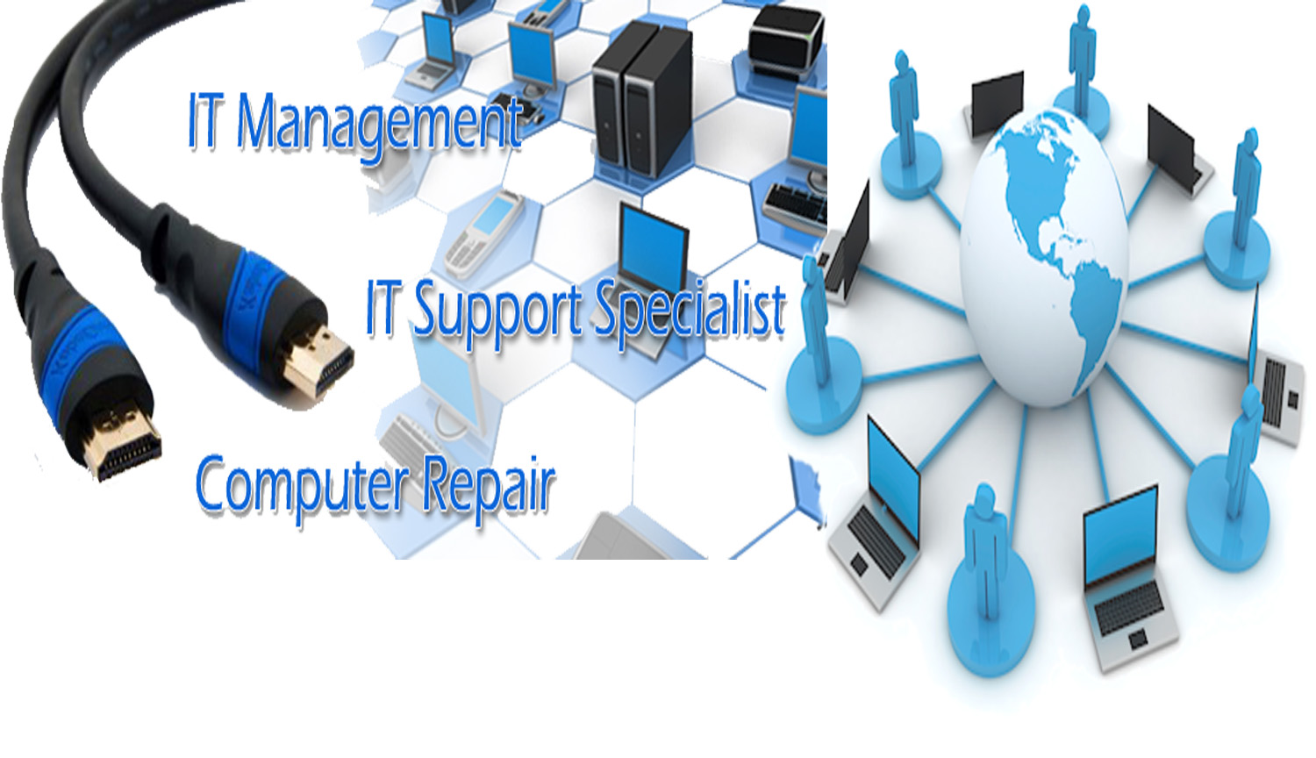

Slide 5
Defining Information
What is Information?
Information is any knowledge that comes to our attention. That could be voice, image, text and video
What is data?
Data is information when dealing with the machine

Slide 6
WHAT COUNT AS INFORMATION?

Slide 7
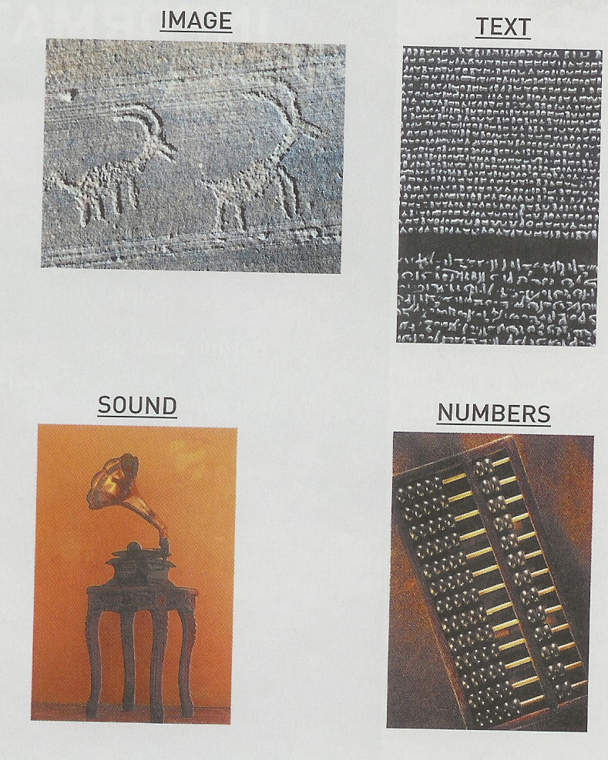
METHODS IN CONVEYING INFORMATION

Slide 8
The Communication Process

Slide 9
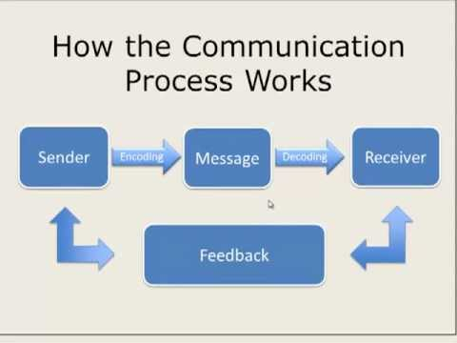

Slide 10
